Slide 1
Circle Drawing Algorithm
(Mid Point Algorithm)
Computer Graphics
Shahnaj Parvin
Lecturer

Slide 2
Circle Drawing Algorithm
Drawing a circle on the screen is a little complex than drawing a line. There are two popular algorithms for generating a circle −
Midpoint Circle Algorithm and
Bresenham’s Algorithm

Slide 3
Mid Point Circle Drawing Algorithm
The midpoint circle drawing algorithm helps us to calculate the complete perimeter points of a circle for the first octant.
We can quickly find and calculate the points of other octants with the help of the first octant points.
The remaining points are the mirror reflection of the first octant points.

Slide 4
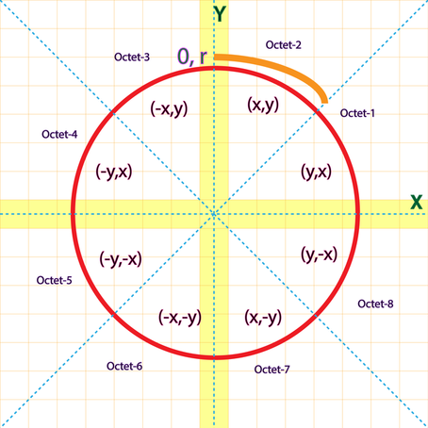
Mid Point Circle Drawing Algorithm

Slide 5
Mid Point Circle Drawing Algorithm
Given the centre point and radius of circle,
Mid Point Circle Drawing Algorithm attempts to generate the points of one octant.
The points for other octacts are generated using the eight symmetry property.

Slide 6
Mid Point Circle Drawing Algorithm Procedure
Given-
Centre point of Circle = (X₀, Y₀)
Radius of Circle = R
The points generation using Mid Point Circle Drawing Algorithm involves the following steps-

Slide 7
Mid Point Circle Drawing Algorithm Procedure
Step-01:
Assign the starting point coordinates (X₀, Y₀) as-
X₀ = 0
Y₀ = R

Slide 8
Mid Point Circle Drawing Algorithm Procedure
Step-02:
Calculate the value of initial decision parameter P_{k} as-
P_{k} = 1 – R

Slide 9
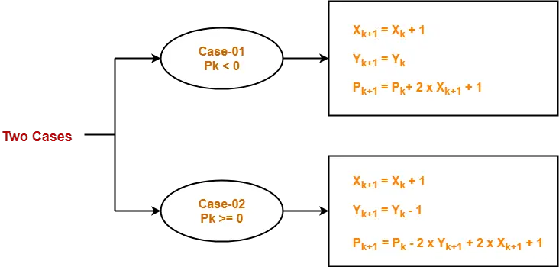
Mid Point Circle Drawing Algorithm Procedure
Step-03:
Suppose the current point is (X_{k}, Y_{k}) and the next point is (X_{k+1}, Y_{k+1}).
Find the next point of the first octant depending on the value of decision parameter P_{k}.
Follow the below two cases-

Slide 10
Mid Point Circle Drawing Algorithm Procedure
Step-04:
If the given centre point (X₀, Y₀) is not (0, 0), then do the following and plot the point-
X_{plot} = X_{c} + X₀
Y_{plot} = Y_{c} + Y₀
Here, (X_{c}, Y_{c}) denotes the current value of X and Y coordinates.

Slide 11
Mid Point Circle Drawing Algorithm Procedure
Step-05:
Keep repeating Step-03 and Step-04 until X_{plot} >= Y_{plot}.

Slide 12
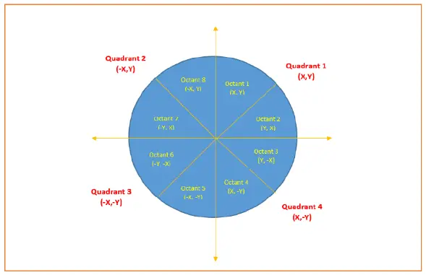
Mid Point Circle Drawing Algorithm Procedure
Step-06:
Step-05 generates all the points for one octant.
To find the points for other seven octants, follow the eight symmetry property of circle.
This is depicted by the following figure-

Slide 13
Mid Point Circle Drawing Algorithm
Problem-01:
Given the centre point coordinates (0, 0) and radius as 10, generate all the points to form a circle.

Slide 14
Mid Point Circle Drawing Algorithm
Problem-01:
Solution-
Given-
Centre Coordinates of Circle (X₀, Y₀) = (0, 0)
Radius of Circle = 10

Slide 15
Mid Point Circle Drawing Algorithm
Problem-01:
Solution-
Step-01:
Assign the starting point coordinates (X₀, Y₀) as-
X₀ = 0
Y₀ = R = 10

Slide 16
Mid Point Circle Drawing Algorithm
Problem-01:
Solution-
Step-02:
Calculate the value of initial decision parameter P_{k} as-
P_{k} = 1 – R
= 1 – 10
= -9

Slide 17
Mid Point Circle Drawing Algorithm
Problem-01:
Solution-
Step-03:
As P_{k} < 0, so case-01 is satisfied.
Thus,
X_{k+1} = X_{k} + 1 = 0 + 1 = 1
Y_{k+1} = Y_{k} = 10
P_{k+1} = P_{k} + 2 * X_{k+1} + 1 = -9 + (2 * 1) + 1 = -6

Slide 18
Mid Point Circle Drawing Algorithm
Problem-01:
Solution-
Step-04:
This step is not applicable here as the given centre point coordinates is (0, 0).

Slide 19
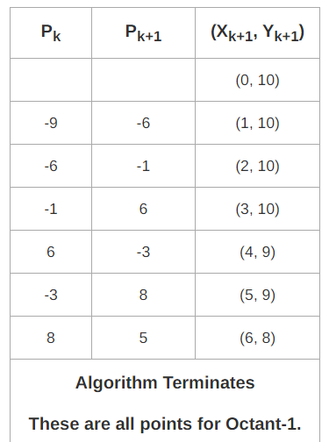
Mid Point Circle Drawing Algorithm
Problem-01:
Solution-
Step-05:
Step-03 is executed similarly until X_{k+1} >= Y_{k+1} as follows-

Slide 20
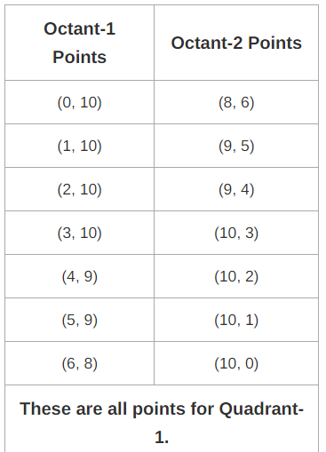
Mid Point Circle Drawing Algorithm
Problem-01:
Solution-
Algorithm calculates all the points of octant-1 and terminates.
Now, the points of octant-2 are obtained using the mirror effect by swapping X and Y coordinates.

Slide 21
Mid Point Circle Drawing Algorithm
Problem-01:
Solution-
Now, the points for rest of the part are generated by following the signs of other quadrants.
The other points can also be generated by calculating each octant separately.

Slide 22
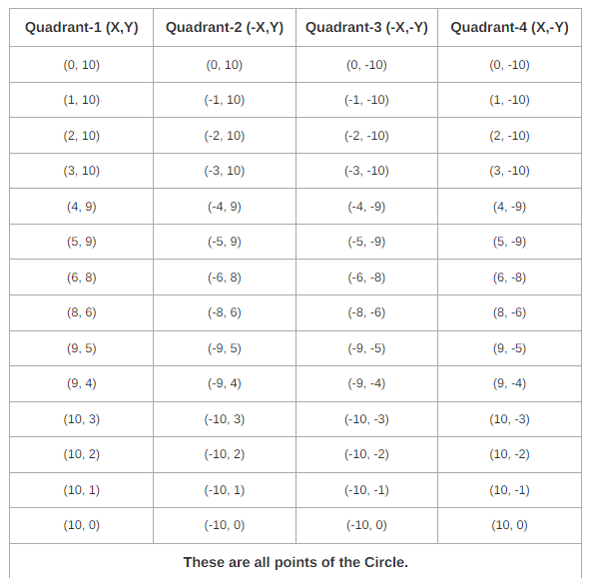
Mid Point Circle Drawing Algorithm

Slide 23
Mid Point Circle Drawing Algorithm
Problem-02:
Given the centre point coordinates (4, 4) and radius as 10, generate all the points to form a circle.

Slide 24
Mid Point Circle Drawing Algorithm
Problem-02:
Solution-
Given-
Centre Coordinates of Circle (X₀, Y₀) = (4, 4)
Radius of Circle = 10

Slide 25
Mid Point Circle Drawing Algorithm
Problem-02:
Solution-
As stated in the algorithm,
We first calculate the points assuming the centre coordinates is (0, 0).
At the end, we translate the circle.

Slide 26
Mid Point Circle Drawing Algorithm
Problem-02:
Solution-
Step-01, Step-02 and Step-03 are already completed in Problem-01.
Now, calculate the values of X_{plot} and Y_{plot} using the formula given in Step-04 of the main algorithm.

Slide 27
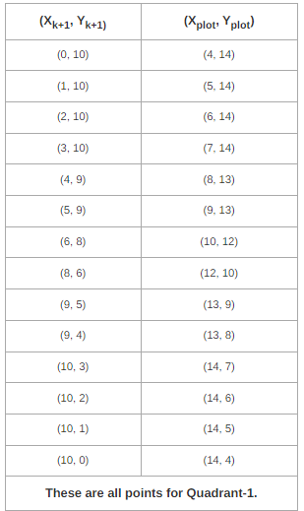
Mid Point Circle Drawing Algorithm
Problem-02:
Solution-
The following table shows the generation of points for Quadrant-1-
X_{plot} = X_{c} + X₀ = X_{k+1} + 4
Y_{plot} = Y_{c} + Y₀ = Y_{k+1} + 4

Slide 28
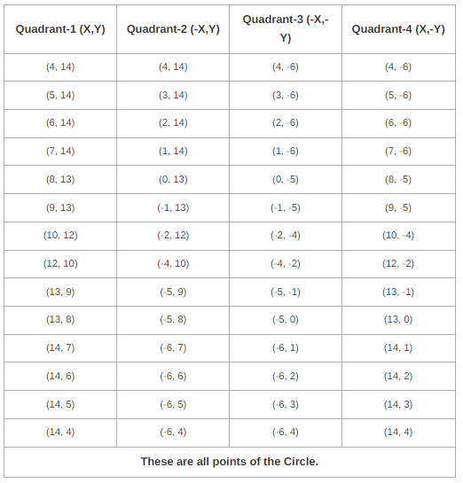
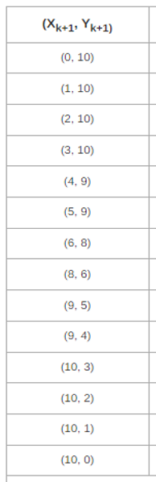
Mid Point Circle Drawing Algorithm

Slide 29
Mid Point Circle Drawing Algorithm
Problem-03:
Find the points on a circle on of its octants with the circle centered at (5,5) and has a radius of 8 units.

